Slide 1
Module Code: CIT221
Module Title: JAVA PROGRAMMING/OBJECT ORIENTED PROGRAMMING WITH JAVA
School: Computing and Information Technology
Year: 2
Credits: 10
By: MR. MANIRARORA JMV

Slide 2
Class instructions
watch
Keep aside your phones,
100% attendance required,
Time management is needed,
QUIZ ,in class activities ,assignments , group assignments and Presentations .
2

Slide 3
Contents
Basics of programming in Java Language
Object Oriented concepts and their implementation in Java
Event Driven Programming with Java, Java Database Connectivity, and multithreading

Slide 4
History of java
Java was created at Sun Microsystems, where James Gosling led a team of researchers in an effort to create a new language that would allow consumer electronic devices to communicate with each other. Work on the language began in 1991, and before long the team's focus changed to a new niche, the World Wide Web.

Slide 5
Chap I:
Basics of programming in Java Language

Slide 6
What is Java?
Java is a high level, object-oriented and secured programming language and it is also called as a platform.
Platform: Any software or hardware environment in which a program runs is known as a platform. Java has its own runtime environment (JRE) and API so java is also called as platform. Java fallows the concept of Write Once, Run Anywhere.
It is now owned by Oracle, and more than 3 billion devices run Java.

Slide 7
Application of java
Mobile applications (specially Android apps)
Desktop applications
Web applications
Web servers and application servers
Enterprise Applications
Games
Database connection
And much more!

Slide 8
Features of Java:
Object Oriented: Java implements basic concepts of Object oriented programming System (OOPS) i.e. Object, Class, Inheritance, Polymorphism, Abstraction, Encapsulation. In Java, everything is an Object. Java can be easily extended since it is based on the Object model.
Platform Independent: Java byte code is distributed over the web and interpreted by the Virtual Machine (JVM) on whichever platform it is being run on.
Simple: Java fallows the basic Syntax of C,C++.
Secure: With Java's secure feature it enables to develop virus-free, tamper-free systems.

Slide 9
Features of Java cont’d
Robust: Java makes an effort to eliminate errors.
Multithreaded: In java we can write programs that can perform many tasks simultaneously.
Interpreted: Java byte code is translated on the fly to native machine instructions and is not stored anywhere.
Distributed: Java is designed for the distributed environment of the internet.
Dynamic: Java is considered to be more dynamic than C or C++ since it is designed to adapt to an evolving environment.

Slide 10
Why Use Java?
Java works on different platforms (Windows, Mac, Linux, Raspberry Pi, etc.)
It is one of the most popular programming language in the world
It is easy to learn and simple to use
It is open-source and free
It is secure, fast and powerful
It has a huge community support (tens of millions of developers)
Java is an object oriented language which gives a clear structure to programs and allows code to be reused, lowering development costs

Slide 11
Java Syntax
public class Main
{
public static void main(String[] args)
{
System.out.println("Hello World");
}
}

Slide 12
Java Program Structure
A Java program consists of the following basic elements:
Class: The basic building block of Java programs. Every Java program must contain at least one class.
Method: A block of code that performs a specific task. A method belongs to a class.
Statements: Instructions that the program executes, such as printing output or performing calculations.

Slide 13
public: Access modifier, which means the class can be accessed from other classes.
class: Keyword used to define a class.
main: The entry point of the program. The main method is where the program starts executing.
System.out.println(): This is a statement that prints text to the console.

Slide 14
Procedure to write simple java Program
First we have install the JDK. To create a simple java program, you need to create a class that contains main method. Let's understand the requirement first:
• install the JDK((includes the JRE, Java compiler, and JVM) and install it,
• set path of the jdk,
• create the java program,
• compile and run the java program.

Slide 15
The Java Development Kit (JDK) is a software development kit that contains everything you need to develop and run Java programs.
The JDK includes:
Java Runtime Environment (JRE): A set of libraries and tools necessary to run Java programs.
Java Compiler (javac): Converts Java source code (.java files) into bytecode (.class files), which can be executed by the Java Virtual Machine (JVM).
Java Virtual Machine (JVM): Executes the bytecode on the platform you're using. The JVM is part of the JRE.
To run Java, you need at least the JRE (which comes bundled with the JDK), but if you want to develop Java programs, you will need the full JDK.

Slide 16
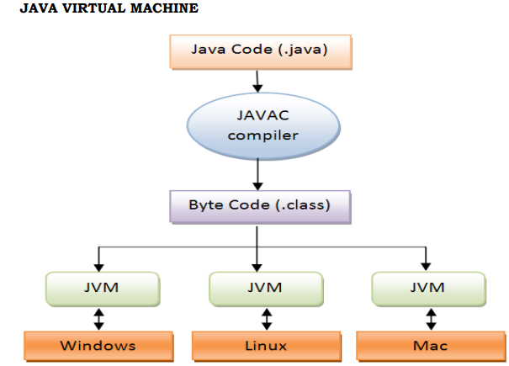
JAVA VIRTUAL MACHINE

Slide 17
Download the JDK: You can download the JDK from Oracle's website or from OpenJDK distributions like AdoptOpenJDK.

Slide 18
RUN A JAVA PROGRAM FROM CMD
Example of compiling and running a Java program from the command line:
Write your Java code in a file named HelloWorld.java.
Open the command line or terminal.
Navigate to the directory where the .java file is located.
Compile the program: javac HelloWorld.java
Run the program: java HelloWorld

Slide 19
Integrated Development Environment (IDE)
While you can write Java code using a simple text editor and compile it from the command line, using an IDE can make development easier. Popular Java IDEs include:
IntelliJ IDEA: A powerful, feature-rich IDE for Java development.
Eclipse: A widely-used open-source IDE for Java programming.
NetBeans: Another open-source IDE for Java with great support for Java EE, JavaFX, etc.

Slide 20
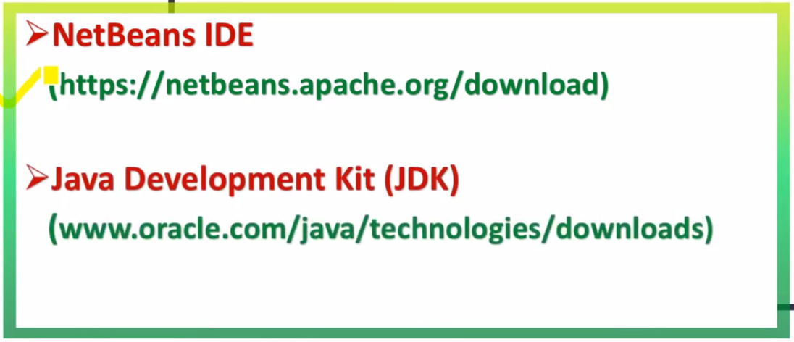
SOFTWARE REQUIRED TO RUN JAVA PROGRAM
S/W:

Slide 21
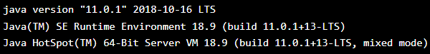
Check if Java has been installed using CMD
To check if you have Java installed on a Windows PC, search in the start bar for Java or type the following in Command Prompt (cmd.exe):
If Java is installed, you will see something like this (depending on version):

Slide 22
Check if NetBeans has been installed using CMD
Use the following command in CMD:
dir "C:\Program Files\NetBeans" /s /b

Slide 23
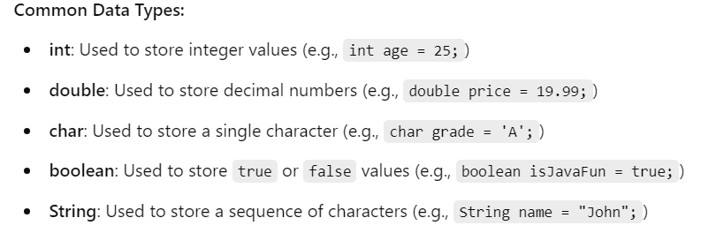
Java Variables and Data Types
In Java, a variable is a container for storing data values. Every variable must have a specific type, which determines what kind of data it can store.

Slide 24
Complete Example Program
Here's a simple Java program using all these common data types:
public class DataTypesExample {
public static void main(String[] args) {
// Using primitive data types
int age = 25; // Integer
double price = 19.99; // Decimal
char grade = 'A'; // Single character
boolean isJavaFun = true; // Boolean
String name = "John"; // String (sequence of characters)
// Printing out the values
System.out.println("Name: " + name);
System.out.println("Age: " + age);
System.out.println("Price: $" + price);
System.out.println("Grade: " + grade);
System.out.println("Is Java fun? " + isJavaFun);
}
}

Slide 25
Output
Name: John
Age: 25
Price: $19.99
Grade: A
Is Java fun? true

Slide 26
Example2
public class DataTypesExample {
public static void main(String[] args) {
// Declare variables with common data types
// Integer data type (int)
int age = 25; // stores an integer value representing age
// Double data type (double)
double price = 19.99; // stores a decimal value representing price
// Character data type (char)
char grade = 'A'; // stores a single character representing grade
// Boolean data type (boolean)
boolean isJavaFun = true; // stores a boolean value indicating if Java is fun
// String data type (String)
String name = "John"; // stores a sequence of characters (text)

Slide 27
Example2 cont’d
// Print out the values to the console
System.out.println("Name: " + name); // Output: Name: John
System.out.println("Age: " + age); // Output: Age: 25
System.out.println("Price: $" + price); // Output: Price: $19.99
System.out.println("Grade: " + grade); // Output: Grade: A
System.out.println("Is Java fun? " + isJavaFun); // Output: Is Java fun? true
// Perform a simple calculation using the double and int variables
double totalPrice = price * age; // Calculates the total price (price * age)
System.out.println("Total Price (Price * Age): $" + totalPrice); // Output: Total Price (Price * Age): $499.75
}
}

Slide 28
JAVA OPERATORS
Operators are symbols used to perform operations on variables and values.
Arithmetic Operators: +, -, *, /, %
Relational Operators: ==, !=, >, <, >=, <=
Logical Operators: && (AND), || (OR), ! (NOT)
Assignment Operator: =
Example:
int a = 5;
int b = 10;
int sum = a + b; // sum = 15
Note: examples found in java control flow statements below:

Slide 29
JAVA CONTROL FLOW STATEMENTS
Java control flow statements allow you to control the execution flow of your program based on certain conditions or loops.
The main types of control flow statements in Java are:
Conditional Statements:
if
if-else
if-else if-else
switch
2. Looping Statements:
for loop
while loop
do-while loop
3. Jump Statements:
break
continue
return

Slide 30
1. Conditional Statements: 1. if Statement
Executes a block of code if the condition is true.
Example:
public class IfExample {
public static void main(String[] args) {
int number = 10;
if (number > 5) {
System.out.println("Number is greater than 5");
}
}
}
Output:
Number is greater than 5

Slide 31
2. if-else Statement
Executes one block of code if the condition is true, and another if it is false.
Example:
public class IfElseExample {
public static void main(String[] args) {
int number = 3;
if (number > 5) {
System.out.println("Number is greater than 5");
} else {
System.out.println("Number is less than or equal to 5");
}
}
}
Output:
Number is less than or equal to 5

Slide 32
3. if-else if-else Statement
Used for checking multiple conditions.
Example:
public class IfElseIfExample {
public static void main(String[] args) {
int number = 10;
if (number > 15) {
System.out.println("Number is greater than 15");
} else if (number > 5) {
System.out.println("Number is greater than 5 but less than or equal to 15");
} else {
System.out.println("Number is 5 or less");
}
}
}
Output:
Number is greater than 5 but less than or equal to 15

Slide 33
4. switch Statement
Allows you to choose one of many blocks of code to be executed based on a variable’s value.
Example:
public class SwitchExample {
public static void main(String[] args) {
int day = 3;
switch (day) {
case 1:
System.out.println("Monday");
break;
case 2:
System.out.println("Tuesday");
break;
case 3:
System.out.println("Wednesday");
break;

Slide 34
Cont’d
case 4:
System.out.println("Thursday");
break;
case 5:
System.out.println("Friday");
break;
default:
System.out.println("Weekend");
}
}
}

Slide 35
Examples
Below are some typical examples of Java programs that use conditional statements, found in everyday software or applications:
Login System (Authentication)
public class JavaConditions {
public static void main(String[]args) {
String username="john";
int password=123;
if("john".equals(username) && password==123)
{
System.out.println("Login successful!");
}
else {
System.out.println("Invalid username or password.");
}
}
}

Slide 36
2. Online Shopping Cart (Discount Calculation)
In an online shopping application, conditional statements can be used to apply a discount based on the total price of items in the cart.
public class JavaConditions {
public static void main(String[]args) {
double totalPrice = 150.0;
if (totalPrice > 100) {
totalPrice *= 0.9; // 10% discount
System.out.println("Discount applied. New total: " + totalPrice);
} else {
System.out.println("No discount applied.");
}
}
}

Slide 37
3. Bank Loan Eligibility Check
A loan application system that checks the applicant's age, income, and credit score to determine if they are eligible for a loan.
public class JavaConditions {
public static void main(String[]args) {
int age = 25;
double income = 3000.0;
int creditScore = 700;
if (age >= 18 && income >= 2500 && creditScore >= 650) {
System.out.println("Loan approved.");
} else {
System.out.println("Loan not approved. Criteria not met.");
}
}
}

Slide 38
4. Weather App (Clothing Recommendation)
A weather app can recommend clothing based on the current temperature. If it's cold, it recommends warm clothes; if it's hot, it suggests lighter clothing.
public class JavaConditions {
public static void main(String[]args) {
int temperature = 10; // in Celsius
if (temperature < 5) {
System.out.println("Wear a heavy coat.");
} else if (temperature >= 5 && temperature < 20) {
System.out.println("Wear a light jacket.");
} else {
System.out.println("Wear a t-shirt.");
}
}
}

Slide 39
5.Bank Account (Balance Check and Withdrawal)
In a banking application, when a user attempts to withdraw money, the system checks if the balance is sufficient to cover the withdrawal request.
public class JavaConditions {
public static void main(String[]args) {
double balance = 500.0;
double withdrawalAmount = 300.0;
if (balance >= withdrawalAmount) {
balance -= withdrawalAmount;
System.out.println("Withdrawal successful. New balance: " + balance);
} else {
System.out.println("Insufficient funds.");
}
}
}

Slide 40
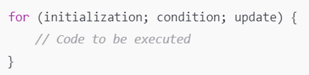
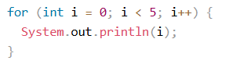
2. Looping Statements
In Java, looping statements allow you to repeatedly execute a block of code as long as a specified condition is true.
for loop: Used when the number of iterations is known ahead of time.
Example: syntax:
public class ForLoopExample {
public static void main(String[] args) {
for (int i = 1; i <= 5; i++) {
System.out.println("Iteration " + i);
}
}
}
try this:
Output:
Iteration 1
Iteration 2
Iteration 3
Iteration 4
Iteration 5

Slide 41
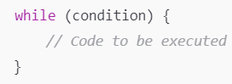
2. while loop
Used when the number of iterations is not known, but you want to repeat a block of code as long as a condition is true.
Example: syntax:
public class WhileLoopExample {
public static void main(String[] args) {
int i = 1;
while (i <= 5) {
System.out.println("Iteration " + i);
i++;
}
}
}
Output:
Iteration 1
Iteration 2
Iteration 3
Iteration 4
Iteration 5

Slide 42
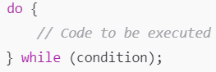
3. do-while loop
The code block will be executed at least once, and then repeated as long as the condition is true.
Example: syntax:
public class DoWhileLoopExample {
public static void main(String[] args) {
int i = 1;
do {
System.out.println("Iteration " + i);
i++;
} while (i <= 5);
}
}
Output:
Iteration 1
Iteration 2
Iteration 3
Iteration 4
Iteration 5

Slide 43
3. Jump Statements:
Jump Statements (break, continue, return) help control the flow of execution inside loops or methods.
break: Exits the loop or switch statement prematurely.
Example:
public class BreakExample {
public static void main(String[] args) {
for (int i = 1; i <= 10; i++) {
if (i = = 5) {
break; // Exit the loop when i is 5
}
System.out.println("Iteration " + i);
}
}
}
Output:
Iteration 1
Iteration 2
Iteration 3
Iteration 4

Slide 44
2. continue
Continue: Skips the current iteration of the loop and proceeds to the next iteration.
Example:
public class ContinueExample {
public static void main(String[] args) {
for (int i = 1; i <= 5; i++) {
if (i = = 3) {
continue; // Skip when i is 3
}
System.out.println("Iteration " + i);
}
}
}
Output:
Iteration 1
Iteration 2
Iteration 4
Iteration 5

Slide 45
3. return
Return: Exits from the current method.
Example:
public class ReturnExample {
public static void main(String[] args) {
System.out.println("Before return");
return; // Exit the method
// This code will not be executed
System.out.println("After return");
}
}
Output:
Before return

Slide 46
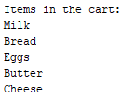
Example
Counting Items in a Store (For Loop)
public class JavaConditions {
public static void main(String[] args) {
String[] cartItems = {"Milk", "Bread", "Eggs", "Butter", "Cheese"};
// Using a for loop to count the items in the cart
System.out.println("Items in the cart:");
for (int i = 0; i < cartItems.length; i++) {
System.out.println(cartItems[i]);
} output:
}
}

Slide 47
Java Arrays
Array is a container/data structure used to store multiple values of the same type in a single variable, instead of declaring separate variables for each value.
To declare an array, define the variable type with square brackets like:
We have now declared a variable that holds an array of strings. To insert values to it, you can place the values in a comma-separated list, inside curly braces:
To create an array of integers, you could write:

Slide 48
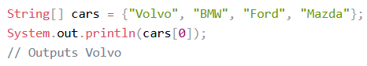
Access the Elements of an Array
You can access an array element by referring to the index number.
This statement accesses the value of the first element in cars:
Note: Array indexes start with 0: [0] is the first element. [1] is the second element, etc.

Slide 49
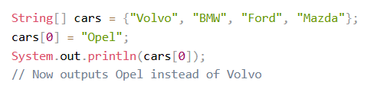
Change an Array Element
To change the value of a specific element, refer to the index number:
Example:

Slide 50
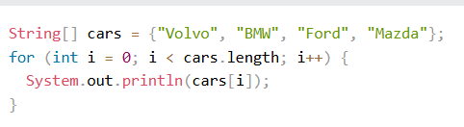
Loop Through an Array
You can loop through the array elements with the for loop, and use the length property to specify how many times the loop should run.
The following example outputs all elements in the cars array:

Slide 51
Simple array example
public class ArrayExample {
public static void main(String[] args) {
// Declare and initialize an array
int[] numbers = {10, 20, 30, 40, 50};
// Accessing and printing elements of the array
System.out.println("First element: " + numbers[0]); // 10
System.out.println("Second element: " + numbers[1]); // 20
// Using a loop to print all elements
System.out.println("All elements in the array:");
for (int i = 0; i < numbers.length; i++) {
System.out.println(numbers[i]);
}
}
}

Slide 52
Multidimensional Arrays
A multidimensional array is an array of arrays.
Multidimensional arrays are useful when you want to store data as a tabular form, like a table with rows and columns.
To create a two-dimensional array, add each array within its own set of curly braces:

Slide 53
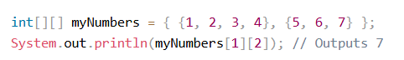
Access Elements in multidimensional array
To access the elements of the myNumbers array, specify two indexes: one for the array, and one for the element inside that array. This example accesses the third element (2) in the second array (1) of myNumbers:
Remember that: Array indexes start with 0: [0] is the first element. [1] is the second element, etc.

Slide 54
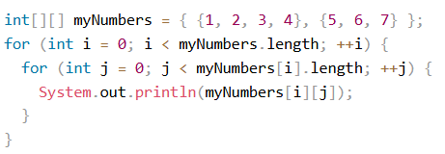
Loop Through a Multi-Dimensional Array
You can also use a for loop inside another for loop to get the elements of a two-dimensional array (we still have to point to the two indexes):
Example:

Slide 55
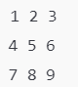
Example 2:Looping through a 2D array
public class Main {
public static void main(String[] args) {
// Declare and initialize a 2D array
int[][] array = {
{1, 2, 3},
{4, 5, 6},
{7, 8, 9}
};
// Loop through the 2D array
for (int i = 0; i < array.length; i++) { // Outer loop (rows)
for (int j = 0; j < array[i].length; j++) { // Inner loop (columns)
System.out.println(array[i][j] + " ");
}
System.out.println(); // Move to the next line after each row
}
} Output:
}

Slide 56
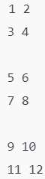
Example3: Looping through a 3D array
public class Main {
public static void main(String[] args) {
// Declare and initialize a 3D array
int[][][] array = {
{{1, 2}, {3, 4}},
{{5, 6}, {7, 8}},
{{9, 10}, {11, 12}}
};
// Loop through the 3D array
for (int i = 0; i < array.length; i++) { // Outer loop (first dimension)
for (int j = 0; j < array[i].length; j++) { // Second dimension (rows)
for (int k = 0; k < array[i][j].length; k++) { // Third dimension (columns)
System.out.println(array[i][j][k] + " ");
}
System.out.println(); // Move to the next line after each row
}
System.out.println(); // Blank line after each 2D slice output:
}
}
}

Slide 57
HOW TO COMPUTE THE SUMMATION OF ARRAY ELEMENTS IN JAVA
public class ArraySum {
public static void main(String[] args) {
// Define an array of integers
int[] numbers = {1, 2, 3, 4, 5, 6, 7, 8, 9, 10};
// Variable to store the sum of the array elements
int sum = 0;
// Loop through the array and add each element to the sum
for (int i = 0; i < numbers.length; i++) {
sum += numbers[i];
}
// Print the sum of the array elements
System.out.println("The sum of the array elements is: " + sum);
}
}

Slide 58
SUMMARY
For a 2D array, use two for loops: the outer loop for rows and the inner loop for columns.
For a 3D array, you add a third loop for the third dimension.

Slide 59
JAVA METHODS (FUNCTIONS)
A method is a block of code which only runs when it is called.
You can pass data, known as parameters, into a method.
Methods are used to perform certain actions, and they are also known as functions.
Why use methods? To reuse code: define the code once, and use it many times.

Slide 60
Components of a Method in Java:
Access Modifier: Defines the visibility of the method. Common access modifiers are:
public: Accessible from any other class.
private: Accessible only within the same class.
protected: Accessible within the same package or by subclasses.
default (no modifier): Accessible only within the same package.
Return Type: Defines what type of value the method will return. If no value is returned, the return type is void.
Method Name: The name of the method, which should follow Java naming conventions (e.g., lowercase first letter, camelCase for multi-word names).
Parameters (Optional): The inputs to the method, which are defined in parentheses. A method can have zero or more parameters.
Method Body: The block of code that defines what the method does, enclosed in curly braces {}.

Slide 61
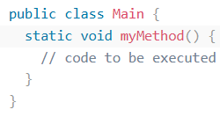
Create a Method
A method must be declared within a class. It is defined with the name of the method, followed by parentheses ().
Java provides some pre-defined methods, such as System.out.println(), but you can also create your own methods to perform certain actions:
Create a method inside Main:

Slide 62
myMethod() is the name of the method
static means that the method belongs to the Main class and not an object of the Main class. You will learn more about objects and how to access methods through objects later in this tutorial.
void means that this method does not have a return value.
Call a Method
To call a method in Java, write the method's name followed by two parentheses () and a semicolon;

Slide 63
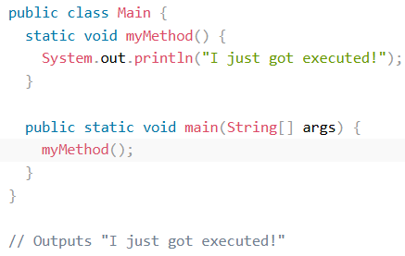
Example

Slide 64
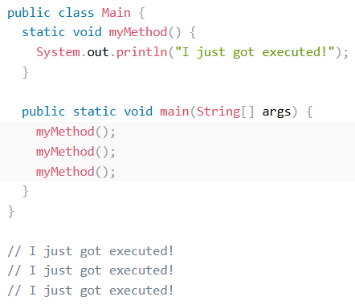
A method can also be called multiple times
Example:

Slide 65
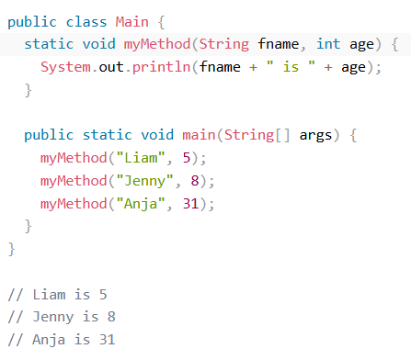
Method with Parameters
Information can be passed to methods as a parameter. Parameters act as variables inside the method.
Example:

Slide 66
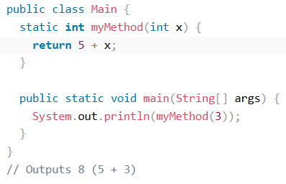
Return Values
In the previous page, we used the void keyword in all examples, which indicates that the method should not return a value.
If you want the method to return a value, you can use a primitive data type (such as int, char, etc.) instead of void, and use the return keyword inside the method:
Example1:

Slide 67
Example2:A method return string
public class Main {
// Method to return a greeting message
public static String getGreeting(String name) {
return "Hello, " + name + "!";
}
public static void main(String[] args) {
// Calling the method and storing the returned value
String greetingMessage = getGreeting("Alice");
// Printing the returned string
System.out.println(greetingMessage);
}
}

Slide 68
Method Overloading
Java allows methods to have the same name but different parameters (method overloading). Here's an example:
public class Main {
// Method to add two integers
public static int add(int a, int b) {
return a + b;
}
// Overloaded method to add three integers
public static int add(int a, int b, int c) {
return a + b + c;
}
public static void main(String[] args) {
// Calling the overloaded methods
System.out.println("Sum of two numbers: " + add(5, 3));
System.out.println("Sum of three numbers: " + add(5, 3, 2));
}
}

Slide 69
Recursive Method
A recursive method is one that calls itself. Below is an example of a recursive method to calculate the factorial of a number.
public class HelloWorld {
// Recursive method to calculate factorial
public static int factorial(int n) {
if (n = = 0) { // Base case: factorial of 0 is 1
return 1;
} else {
return n * factorial(n - 1); // Recursive case
}
}
public static void main(String[] args) {
// Calling the recursive factorial method
System.out.println("Factorial of 5 is: " +factorial(5));
}
}

Slide 70
Examples on Java methods/functions
A Function to Add Two Numbers
This is a simple function that takes two integers as input and returns their sum.
public class Javafunction {
// Function to add two numbers
public static int addNumbers(int a, int b) {
return a + b; // Returns the sum of a and b
}
public static void main(String[] args) {
System.out.println("The sum is: " +addNumbers(5, 3));
}
}

Slide 71
A Function to Find the Maximum of Two Numbers
This function compares two numbers and returns the larger one:
public class Main {
public static void main(String[] args) {
int num1 = 10;
int num2 = 20;
int max = findMax(num1, num2); // Calling the function
System.out.println("The maximum of " + num1 + " and " + num2 + " is: " + max);
}
// Function to find the maximum of two numbers
public static int findMax(int a, int b) {
if (a > b) {
return a;
} else {
return b;
}
}
}

Slide 72
SUMMARY
No Parameters, No Return: Method doesn't take parameters and doesn't return a value (e.g., void methods).
With Parameters, No Return: Method takes input but doesn't return a value.
With Return Value, No Parameters: Method doesn't take input but returns a value.
With Parameters and Return Value: Method takes input and returns a value.
Method Overloading: Methods with the same name but different parameter lists.
Recursion: A method that calls itself.

Slide 73
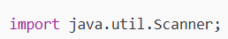
Java User Input (Scanner)
In Java, you can get input from users by using classes like Scanner, which is a part of the java.util package.
The Scanner class allows you to read different types of input such as strings, integers, and floating-point numbers.
Here's a step-by-step guide on how to do it:
Import the Scanner class: First, you need to import the Scanner class from the java.util package.

Slide 74
Java User Input (Scanner) cont’d
2. Create a Scanner object: You then create a Scanner object that will be used to read input from the user.
Here, System.in refers to the standard input stream (keyboard).
3. Read input: Use methods of the Scanner class to read input.
Some commonly used methods are:
nextLine() for reading strings (including spaces).
nextInt() for reading integers.
nextDouble() for reading floating-point numbers.
nextBoolean() for reading boolean values.
4Close the Scanner: After you're done reading input, it's a good practice to close the Scanner object to free up resources.

Slide 75
Example 1: Reading a String
import java.util.Scanner;
public class UserInputExample {
public static void main(String[] args) {
// Create a Scanner object
Scanner scanner = new Scanner(System.in);
// Ask for user input
System.out.print("Enter your name: ");
String name = scanner.nextLine(); // Read a line of text (string)
// Display the input
System.out.println("Hello, " + name + "!");
// Close the scanner
scanner.close();
}
}

Slide 76
Example 2: Reading Multiple Types of Input
import java.util.Scanner;
public class UserInputExample {
public static void main(String[] args) {
// Create a Scanner object
Scanner scanner = new Scanner(System.in);
// Ask for user input
System.out.print("Enter your name: ");
String name = scanner.nextLine(); // Read a string
System.out.print("Enter your age: ");
int age = scanner.nextInt(); // Read an integer
System.out.print("Enter your height: ");
double height = scanner.nextDouble(); // Read a double
// Display the input
System.out.println("Name: " + name);
System.out.println("Age: " + age);
System.out.println("Height: " + height);
// Close the scanner
scanner.close();
}
}

Slide 77
Example: Collecting and Validating User Input
import java.util.Scanner;
public class LoginSystem {
public static void main(String[] args) {
// Create a Scanner object to get input from the user
Scanner scanner = new Scanner(System.in);
// Prompt the user for a username
System.out.print("Enter username: ");
String username = scanner.nextLine(); // Read the user's username
// Prompt the user for a password
System.out.print("Enter password: ");
String password = scanner.nextLine(); // Read the user's password
// Conditional statement to check if the entered username and password are correct
if (username.equals("admin") && password.equals("password123")) {
// If both the username and password are correct
System.out.println("Login successful! Welcome, " + username + ".");
} else {
// If either the username or password is incorrect
System.out.println("Invalid username or password. Please try again.");
}
// Close the scanner to free resources
scanner.close();
}
}

Slide 78
Chap II
OBJECT ORIENTED CONCEPTS AND THEIR IMPLEMENTATION IN JAVA

Slide 79
INTRODUCTION
The high-level programming languages are broadly categorized in to two categories:
Procedure oriented programming(POP) language.
Object oriented programming(OOP) language.
1. Procedure oriented programming(POP) language.
Procedure oriented programming basically consist of writing a list of instruction or actions for the computer to follow and organizing these instruction into groups known as functions.

Slide 80
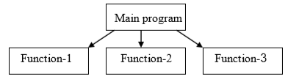
Example
Features/Characteristics of procedure oriented programming:
Emphasis is on doing things(algorithm)
Large programs are divided into smaller programs known as functions.
Most of the functions share global data
Data move openly around the system from function to function
Function transforms data from one form to another.
Employs top-down approach in program design
Examples: languages: c, pascal, etc.

Slide 81
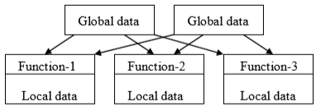
The disadvantages of the procedure oriented programming languages is:
Global data access
It does not model real word problem very well
No data hiding

Slide 82
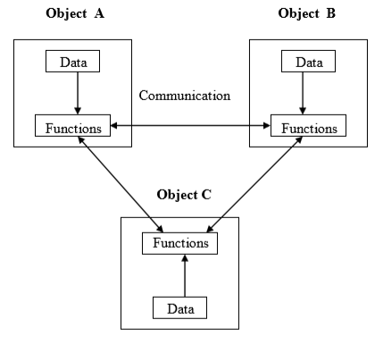
2. Object Oriented Programing
OOP stands for Object-Oriented Programming.
Definition: Object-Oriented Programming (OOP) is a programming paradigm based on the concept of "objects," which can contain both data and methods (functions) that operate on the data. OOP encourages the organization of code into modular, reusable, and organized structures.
Example:

Slide 83
Features of the Object Oriented programming
Emphasis is on doing rather than procedure.
Programs are divided into what are known as objects.
Data structures are designed such that they characterize the objects.
Functions that operate on the data of an object are tied together in the data structure.
Data is hidden and can’t be accessed by external functions.
Objects may communicate with each other through functions.
New data and functions can be easily added.
Follows bottom-up approach in program design.
Examples: languages: Java, Python, C++,etc.

Slide 84
Object Oriented Programing cont’d
Object-Oriented Programming is a methodology or paradigm to design a program using classes and objects.
Object means a real-world entity such as a pen, chair, table, computer, watch, etc.
The aim of object-oriented programming is to implement real-world entities
It simplifies software development and maintenance by providing some concepts (OOP concepts):
Object
Class
Inheritance
Polymorphism
Abstraction
Encapsulation

Slide 85
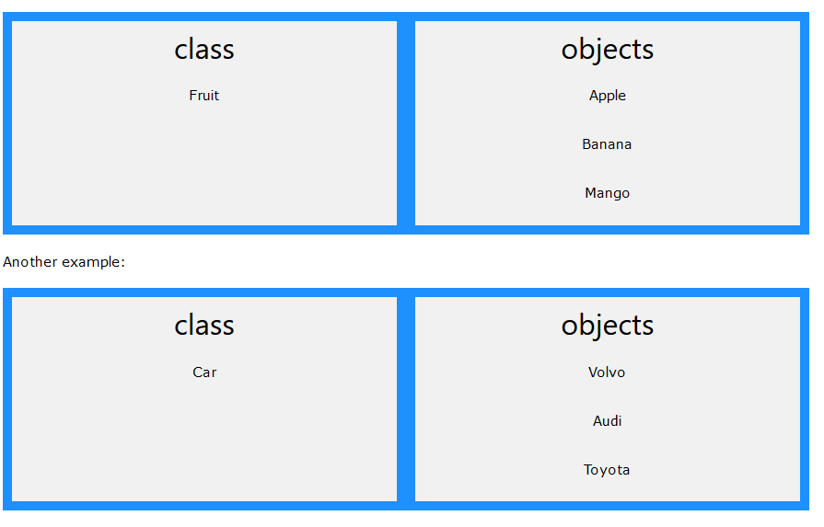
Classes and Objects
Classes and objects are the two main aspects of object-oriented programming.
Look at the following illustration to see the difference between class and objects:

Slide 86
1. Object
Object: An object in java is a collection of data (variables) and methods (functions) that operate on the data. Think of an object as a real-world entity that has attributes and behaviors.
For example, consider a car. It has attributes like color, brand, model, and behaviors like starting the engine, accelerating, and braking.
In java, you can create objects from classes. Each object is an instance of its class (an instance is a copy of the class with actual values).
AN OBJECT CONSISTS OF:
State: It is represented by the attributes of an object. It also reflects the properties of an object.
Behavior: It is represented by the methods of an object. It also reflects the response of an object to other objects.
Identity: It gives a unique name to an object and enables one object to interact with other objects.

Slide 87
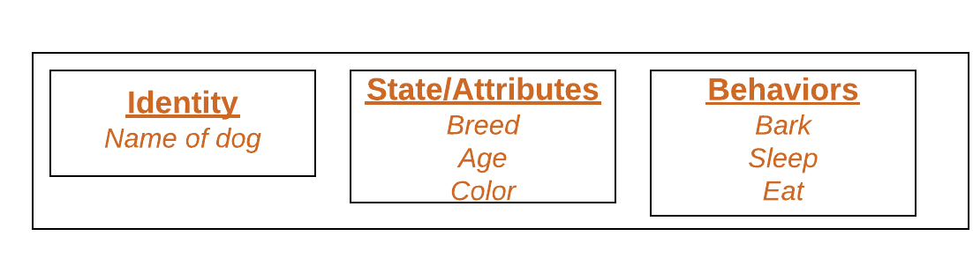
Example: object

Slide 88
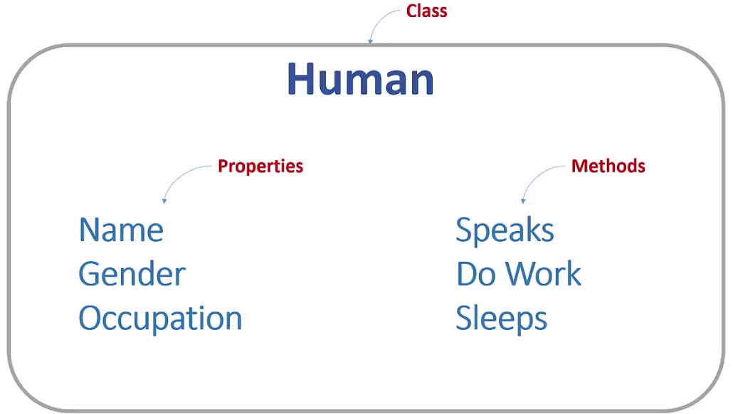
2. Class
A class in java is a blueprint for creating objects. It defines the properties and behaviors that the objects of that class will have (A Class is like an object constructor, or a "blueprint" for creating objects).
Example: class

Slide 89
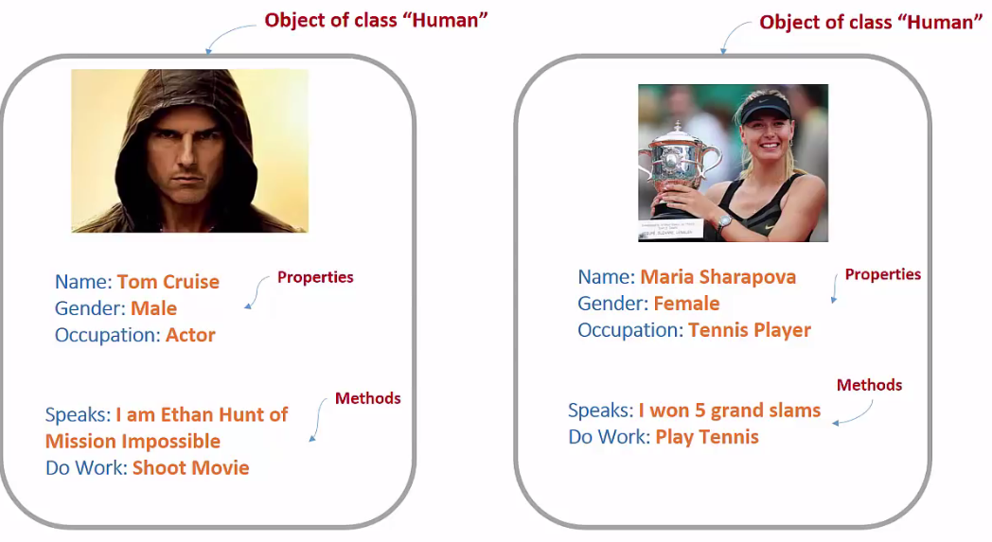
Object of class Human

Slide 90
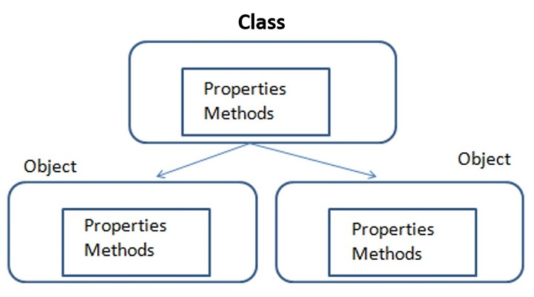
Think about this image

Slide 91
Create an object
In java, an object is created from a class. To create an object in Java, you need to follow these steps:
Define a Class: First, you must define a class that describes the structure and behavior of the object. Example: public class Person
Create an Object (instance) of class: Specify the class name, followed by the object name, and use the keyword new.
Example:
Person person = new Person();

Slide 92
Example1: java program
public class Person {
// Instance variables (attributes)
String name;
int age;
// Main method - the entry point of the program
public static void main(String[] args) {
// Creating an object of the Person class without using a constructor or methods
Person person = new Person(); // This uses the default constructor
// Directly setting values for the attributes (instance variables)
person.name = "Alice";
person.age = 25;
// Displaying values directly
System.out.println("Name: " + person.name);
System.out.println("Age: " + person.age);
}
}

Slide 93
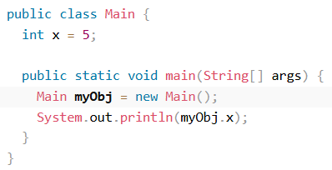
Example2
Create an object called "myObj" and print the value of x:

Slide 94
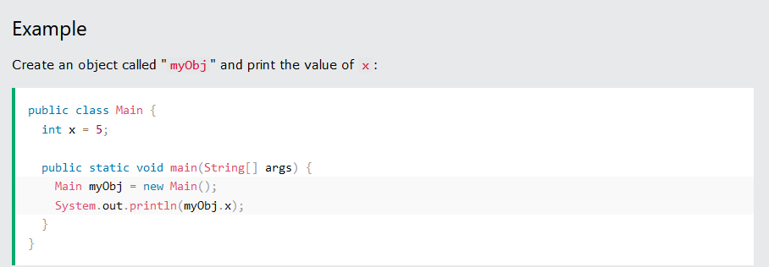
Java Class Attributes & access attributes
Java Class Attributes are variables within a class.
You can access attributes by creating an object of the class, and by using the dot syntax (.)

Slide 95
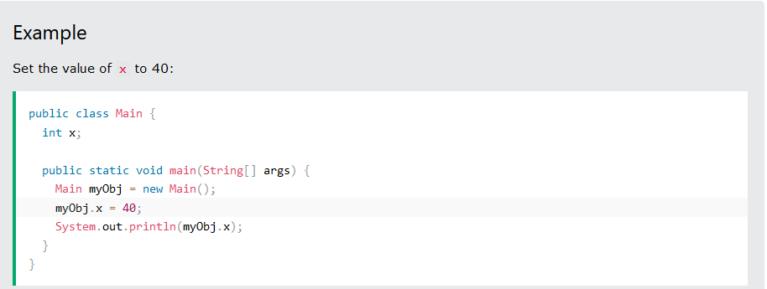
Modify Attributes

Slide 96
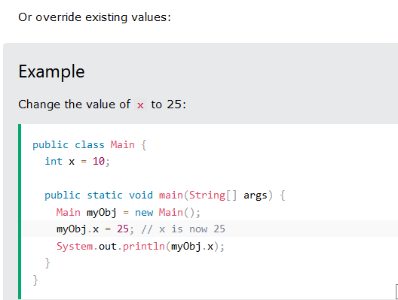

Slide 97
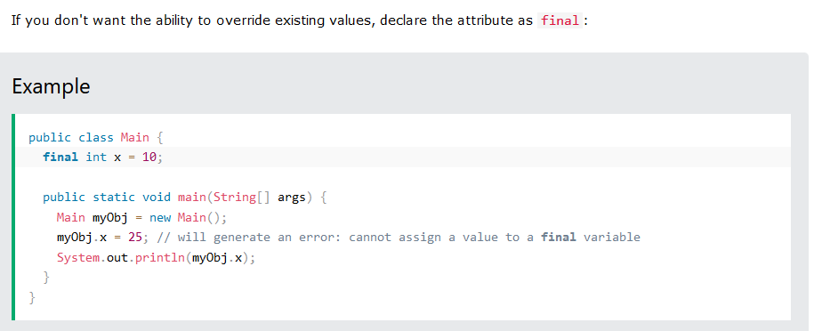

Slide 98
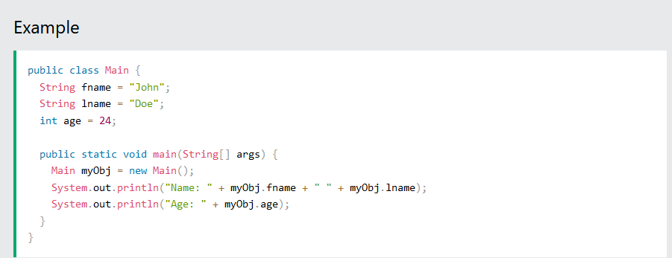
Java Multiple Attributes

Slide 99
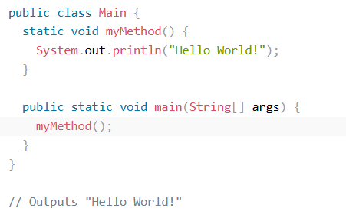
Java Class Methods
You learned from the Java Methods chapter that methods are declared within a class, and that they are used to perform certain actions:
Example:

Slide 100
Static vs. Non-Static
You will often see Java programs that have either static
or public attributes and methods.
In the example above, we created a static method, which means that it can be accessed without creating an object of the class,
Unlike public, which can only be accessed by objects:

Slide 101
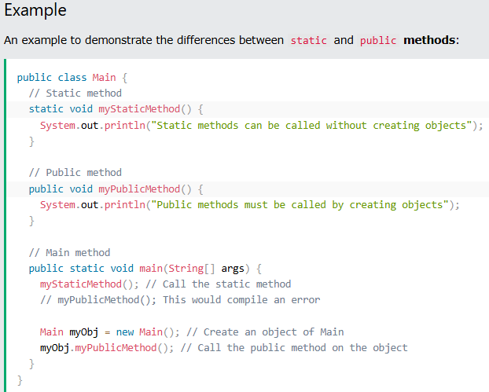
Example

Slide 102
Example2: Java program with method
// Class definition
public class Car {
// Instance variables (attributes)
String model;
int year;
// Constructor to initialize the car object
public Car(String model, int year) {
this.model = model; // Initialize model
this.year = year; // Initialize year
}
// Method to display the details of the car
public void displayDetails() {
System.out.println("Car Model: " + model);
System.out.println("Car Year: " + year);
}
// Main method to run the program
public static void main(String[] args) {
// Creating a car object using the constructor
Car myCar = new Car("Toyota Corolla", 2020);
// Calling the method to display car details
myCar.displayDetails();
}
}

Slide 103
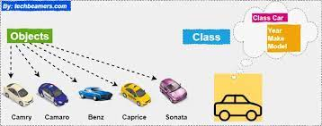
Example3: the image below, can give you an idea to work with class and objects
https://www.geekster.in/articles/java-classes-and-object/#:~:text=The%20class%20represents%20a%20group,object%20of%20the%20Dog%20class.

Slide 104
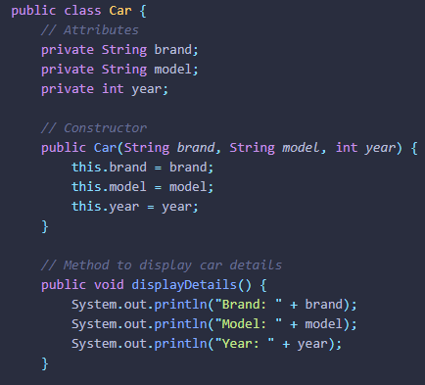
Here’s an example of a Java class and object: consider camry as one object of class Car

Slide 105
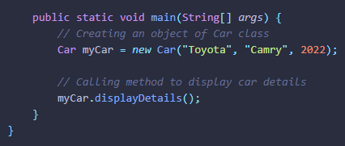
Example Cont’d
.

Slide 106
QUIZ
Create a Car object named myCar. Call the fullThrottle() and speed() methods on the myCar object, and run the program:

Slide 107
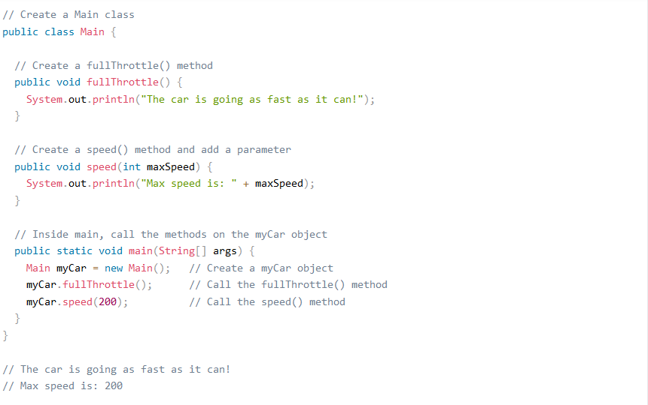
Example

Slide 108
JAVA CONSTRUCTORS
A constructor in Java is a special method that is used to initialize objects. The constructor is called when an object of a class is created. It can be used to set initial values for object attributes.
General Syntax of a Constructor:
class ClassName {
// Constructor
ClassName() {
// Initialization code
}
}

Slide 109
Key Points:
Constructor Name: The constructor must have the same name as the class (ClassName in this case).
No Return Type: Constructors do not have a return type, not even void.
Automatic Invocation: The constructor is automatically called when you create an object using the new keyword.

Slide 110
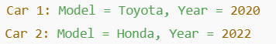
Example: CONSTRUCTOR WITH PARAMETER
public class Car {
// Fields (properties)
String model;
int year;
// Parameterized constructor
Car(String model, int year) {
this.model = model; // Assign parameter 'model' to the field 'model'
this.year = year; // Assign parameter 'year' to the field 'year'
}
// Main method to create objects
public static void main(String[] args) {
// Create objects using the parameterized constructor
Car car1 = new Car("Toyota", 2020); // Object with model "Toyota" and year 2020
Car car2 = new Car("Honda", 2022); // Object with model "Honda" and year 2022
// Display the values of fields
System.out.println("Car 1: Model = " + car1.model + ", Year = " + car1.year);
System.out.println("Car 2: Model = " + car2.model + ", Year = " + car2.year);
}
} output:

Slide 111
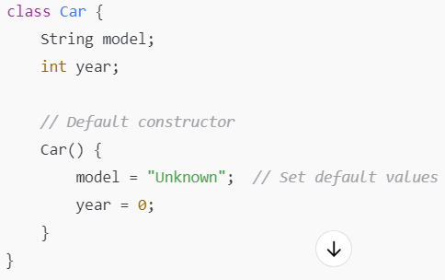
Types of Constructors in Java:
1. Default Constructor (No-Arg Constructor)
If no constructor is explicitly defined, Java provides a default constructor that assigns default values (e.g., null for object references and 0 for numeric types).
Example:

Slide 112
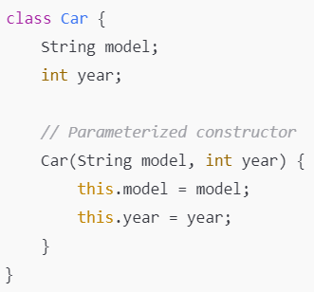
2. Parameterized Constructor:
A constructor that accepts parameters to initialize object fields with specific values when the object is created.
Example:

Slide 113
3. Constructor Overloading:
Java allows constructor overloading, which means you can have multiple constructors in a class with different parameter lists.
class Car {
String model;
int year;
// Default constructor
Car() {
this.model = "Unknown";
this.year = 0;
}
// Parameterized constructor
Car(String model, int year) {
this.model = model;
this.year = year;
}
// Another parameterized constructor
Car(String model) {
this.model = model;
this.year = 2020; // Default year if only the model is provided
}
}

Slide 114
Complete Java Example: Constructors+ method
public class Car {
// Instance variables (fields)
String model;
int year;
// Default constructor (no parameters)
public Car() {
// Setting default values
model = "Unknown";
year = 0;
System.out.println("Default Constructor called");
}
// Parameterized constructor (with parameters)
public Car(String model, int year) {
// Initializing fields with values passed in the constructor
this.model = model;
this.year = year;
System.out.println("Parameterized Constructor called");
}

Slide 115
Example cont’d
// Method to display the details of the car
public void displayInfo() {
System.out.println("Model: " + model);
System.out.println("Year: " + year);
}
// Main method to test the constructors
public static void main(String[] args) {
// Creating an object using the default constructor
Car car1 = new Car();
car1.displayInfo(); // Outputs default values: Unknown and 0
// Creating an object using the parameterized constructor
Car car2 = new Car("Toyota", 2020);
car2.displayInfo(); // Outputs the passed values: Toyota and 2020
}
}

Slide 116
CONSTRUCTOR SUMMARY
Default Constructor: No parameters, assigns default values.
Parameterized Constructor: Takes parameters to initialize fields with specific values.
Constructor Overloading: Allows multiple constructors with different parameter types or numbers of parameters.
Note: By using constructors, you can effectively control the initialization process of your objects in Java.

Slide 117
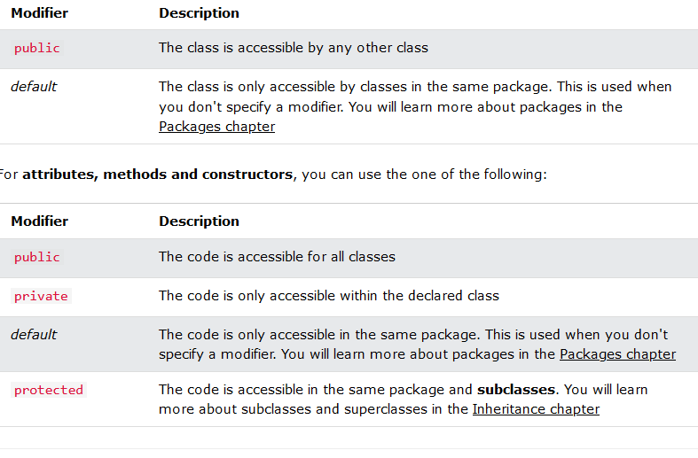
Java access Modifiers

Slide 118
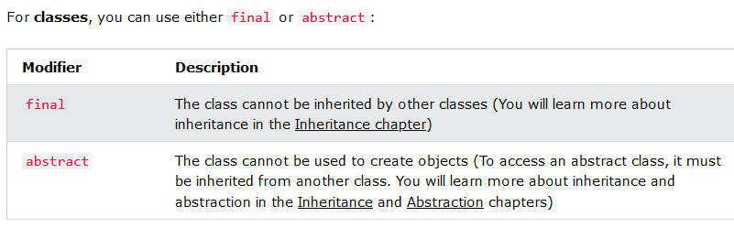
Access Modifiers cont’d

Slide 119
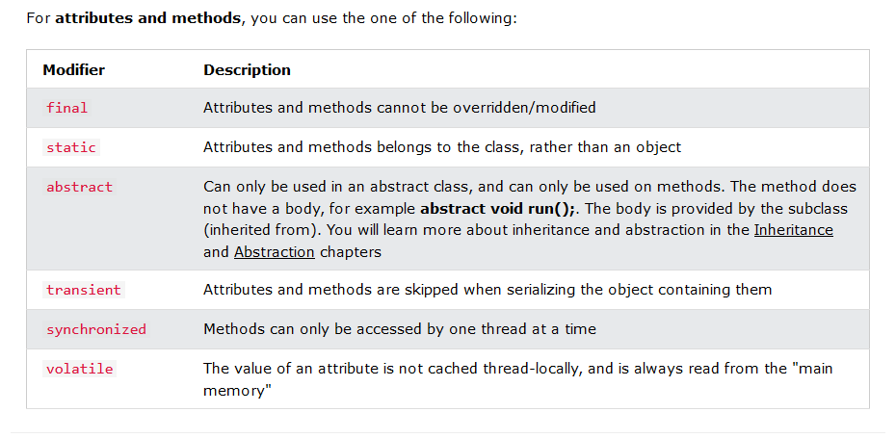

Slide 120
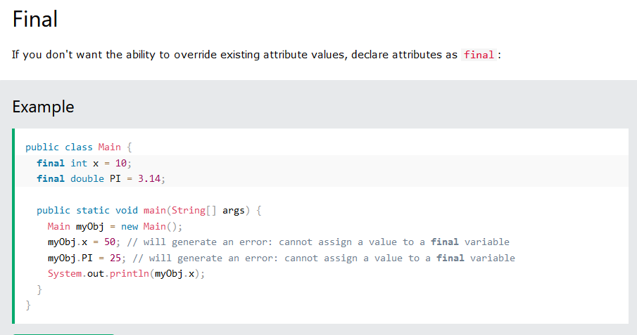
Final

Slide 121
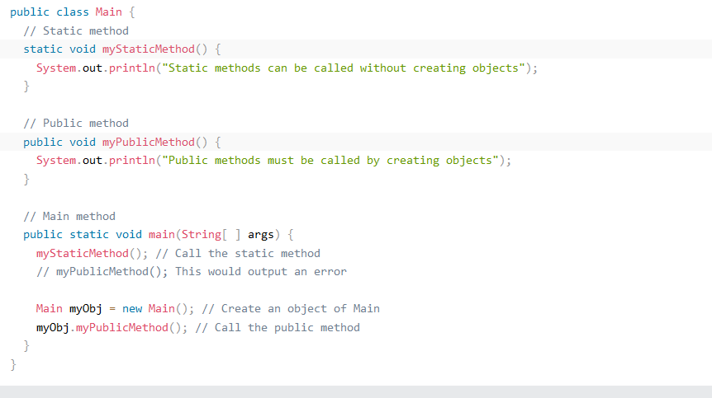
Static A static method means that it can be accessed without creating an object of the class, unlike public:

Slide 122
Java Packages
A package in Java is used to group related classes. Think of it as a folder in a file directory. We use packages to avoid name conflicts, and to write a better maintainable code. Packages are divided into two categories:
Built-in Packages (packages from the Java API)
User-defined Packages (create your own packages)

Slide 123


Slide 124


Slide 125


Slide 126
Examples of java packages and how are imported
import javax.swing.*;
This package is part of the Swing library, which is used to create graphical user interfaces (GUIs) in Java.
import java.awt.*;
This package is part of the Abstract Window Toolkit (AWT), which provides the basic building blocks for creating GUIs in Java.
import java.awt.event.*;
This package contains classes and interfaces related to event handling in Java.
import java.sql.*;
This package is part of the Java Database Connectivity (JDBC) API, which allows Java applications to connect to and interact with relational databases (like MySQL, PostgreSQL, or SQLite

Slide 127
3. Java Inheritance (Subclass and Superclass)
Java inheritance is a fundamental concept in object-oriented programming (OOP) that allows a class to inherit properties and behaviors (fields and methods) from another class.
The class that is inherited from is called the parent class or superclass, and the class that inherits from it is called the child class or subclass.
Example: A class Dog can inherit from a class Animal.
https://www.javatpoint.com/types-of-inheritance-in-java
https://www.masterincoding.com/inheritance-in-java/

Slide 128

Why use Inheritance in Java?
The main advantage of inheritance is code reusability and also method overriding (runtime polymorphism).
Inheritance is also known as the IS-A relationship.
Think of real-world relationships:
Inheritance is called the IS-A relationship because a subclass is a type of the superclass.

Slide 129

Java Inheritance Cont’d
.

Slide 130


Slide 131
Example2: Java Inheritance in Action
class Vehicle {
void start() {
System.out.println("The vehicle starts.");
}
}
class Car extends Vehicle {
void honk() {
System.out.println("The car honks.");
}
}
public class Main {
public static void main(String[] args) {
Car myCar = new Car();
myCar.start(); // Inherited from Vehicle class
myCar.honk(); // Specific to Car class
}
}

Slide 132

Example2: java inheritance: with attributes and methods.
class Vehicle {
String name;
String price;
void start() {
System.out.println("The vehicle starts.");
}
}
class Car extends Vehicle {
void honk() {
System.out.println("The car honks.");
}
}
public class Main {
public static void main(String[] args) {
Car myCar = new Car();
myCar.name ="BMW3";
myCar.price ="$3000";
myCar.start(); // Inherited from Vehicle class
myCar.honk(); // Specific to Car class
System.out.println(myCar.name);
System.out.println(myCar.price); output:
}
}

Slide 133

.
.

Slide 134
Types of Inheritance
Java supports the following four types of inheritance:
Single Inheritance
Multi-level Inheritance
Hierarchical Inheritance
Hybrid Inheritance

Slide 135

1. Single Inheritance
In single inheritance, a sub-class is derived from only one super class. It inherits the properties and behavior of a single-parent class. Sometimes it is also known as simple inheritance.
EXAMPLE:

Slide 136


Let's implement the single inheritance mechanism in a Java program.
.

Slide 137


Slide 138

2. Multi-level Inheritance
In multi-level inheritance, a class is derived from a class which is also derived from another class is called multi-level inheritance. In simple words, we can say that a class that has more than one parent class is called multi-level inheritance.

Slide 139

Example: Multi-level Inheritance
//super class
class Student
{
int reg_no;
void getNo(int no)
{
reg_no=no;
}
void putNo()
{
System.out.println("registration number= "+reg_no);
}
}
//intermediate sub class
class Marks extends Student
{
float marks;
void getMarks(float m)
{
marks=m;
}
void putMarks()
{
System.out.println("marks= "+marks);
}
}
//derived class
class Sports extends Marks
{
float score;
void getScore(float scr)
{
score=scr;
}
void putScore()
{
System.out.println("score= "+score);
}
}
public class MultilevelInheritanceExample
{
public static void main(String args[])
{
Sports ob=new Sports();
ob.getNo(0987);
ob.putNo();
ob.getMarks(78);
ob.putMarks();
ob.getScore(68.7); output:
ob.putScore();
}
}

Slide 140

3. Hierarchical Inheritance
If a number of classes are derived from a single base class, it is called hierarchical inheritance.

Slide 141

HierarchicalInheritance: Example.java
//parent class
class Student
{
public void methodStudent()
{
System.out.println("The method of the class Student invoked.");
}
}
class Science extends Student
{
public void methodScience()
{
System.out.println("The method of the class Science invoked.");
}
}
class Commerce extends Student
{
public void methodCommerce()
{
System.out.println("The method of the class Commerce invoked.");
}
}
class Arts extends Student
{
public void methodArts()
{
System.out.println("The method of the class Arts invoked.");
}
}
public class HierarchicalInheritanceExample
{
public static void main(String args[])
{
Science sci = new Science();
Commerce comm = new Commerce();
Arts art = new Arts();
//all the sub classes can access the method of super class
sci.methodStudent();
comm.methodStudent();
art.methodStudent();
} output:
}

Slide 142

4. Hybrid Inheritance
Hybrid means consist of more than one. Hybrid inheritance is the combination of two or more types of inheritance.

Slide 143

Example: Hybrid inheritance: Daughter.java
//parent class
class GrandFather
{
public void show()
{
System.out.println("I am grandfather.");
}
}
//inherits GrandFather properties
class Father extends GrandFather
{
public void show()
{
System.out.println("I am father.");
}
}
//inherits Father properties
class Son extends Father
{
public void show()
{
System.out.println("I am son.");
}
}
//inherits Father properties
public class Daughter extends Father
{
public void show()
{
System.out.println("I am a daughter.");
}
public static void main(String args[])
{
Daughter obj = new Daughter();
obj.show();
} output:
}

Slide 144
5. Multiple Inheritance (not supported)
Java does not support multiple inheritances due to ambiguity.
One of the primary reasons for not supporting multiple inheritance in Java is to avoid the diamond problem. This occurs when a class inherits from two classes that have methods with the same name. It creates ambiguity about which method to use.

Slide 145

Java Method Overriding:
Method Overriding:
A subclass can override methods of the superclass to provide its own implementation.
Overriding is done by defining a method with the same signature (method name and parameters) as the method in the superclass.
The @Override annotation is typically used to indicate that the method is being overridden.

Slide 146


Example of Method Overriding
.

Slide 147

Constructor Inheritance:
Constructors are not inherited, but the subclass can call a constructor of the superclass using the super() keyword.
If a superclass does not have a no-argument constructor, the subclass must explicitly call a superclass constructor with arguments.
NOTES:

Slide 148
Example inheritance
// Superclass
class Animal {
String name;
// No-argument constructor of the superclass
Animal() {
System.out.println("Animal constructor called");
name = "Unknown Animal";
}
// Constructor with a parameter
Animal(String name) {
System.out.println("Animal constructor with name: " + name);
this.name = name;
}
// Method to display the name of the animal
void displayInfo() {
System.out.println("Animal Name: " + name);
}
}
// Subclass
class Dog extends Animal {
// Constructor of subclass
Dog() {
// Calling the no-argument constructor of the superclass
super();
System.out.println("Dog constructor called");
}
// Constructor with a parameter in subclass
Dog(String name) {
// Calling the parameterized constructor of the superclass
super(name);
System.out.println("Dog constructor with name: " + name);
}
}
public class Main {
public static void main(String[] args) {
// Creating an object of Dog with no parameters
Dog dog1 = new Dog(); // Calls Animal's no-argument constructor
dog1.displayInfo(); // Output: Animal Name: Unknown Animal
System.out.println();
// Creating an object of Dog with a parameter
Dog dog2 = new Dog("Buddy"); // Calls Animal's parameterized constructor
dog2.displayInfo(); // Output: Animal Name: Buddy
}
}

Slide 149


4. Polymorphism in Java
.
Polymorphism in Java is a single method having multiple functions under the same name. A single-action gets executed in different ways.
Polymorphism is derived from 2 Greek words: poly and morphs. The word “poly” means many, and “morphs” means forms. So, Polymorphism means many forms.

Slide 150
Benefits of Polymorphism
Code Reusability: Polymorphism allows you to reuse code across different classes and objects. You can call the same method on objects of different types and expect it to work according to the object type.
Flexibility: It allows for more flexible and extensible code. You can extend the functionality of existing classes without changing their code.
Maintainability: By using polymorphism, code is often more modular and easier to maintain. It reduces the need to write multiple methods for similar actions, thus simplifying the code.

Slide 151


TYPES OF POLYMORPHISM: In Java, polymorphism is of two types:
.

Slide 152


.
.

Slide 153

Java polymorphism: Real-life example
You have a smartphone, and you can communicate with your friend. The communication mode you choose could be anything. You can do a call, a text message, mail, etc. So, there is a common goal which is communication, but their approach is different. Therefore, It is called Polymorphism.

Slide 154
1. Compile-time Polymorphism (Static Polymorphism)
Static polymorphism resolve as a compile-time. Also, this Static Polymorphism can achieve by method overloading.
The most common example of compile-time polymorphism is method overloading and operator overloading.
Method Overloading: In method overloading, multiple methods have the same name but different parameters (either in type, number, or both). The method is chosen based on the arguments passed during the method call.

Slide 155
Example1 of Method Overloading in Java:
class Calculator {
// Method to add two integers
public int add(int a, int b) {
return a + b;
}
// Overloaded method to add three integers
public int add(int a, int b, int c) {
return a + b + c;
}
}
public class Main {
public static void main(String[] args) {
Calculator calc = new Calculator();
System.out.println(calc.add(5, 10)); // Calls the add(int, int) method
System.out.println(calc.add(5, 10, 15)); // Calls the add(int, int, int) method
}
}

Slide 156

Example2
.

Slide 157
2. Run-time Polymorphism (Dynamic Polymorphism)
It’s a process resolved at runtime. Dynamic Polymorphism can achieve by method overriding.
Method Overriding: In method overriding, a subclass provides its own version of a method that is already defined in its superclass. The method in the subclass has the same signature (name, return type, and parameters) as the method in the superclass.

Slide 158

Example of Method Overriding in Java
.

Slide 159


Cont’d

Slide 160


Polymorphism in Action
.

Slide 161

Cont’d
.

Slide 162

Difference between overloading and overriding
1. Method overloading in java is possible within the class. Method overloading in Java means multiple methods having the same name but different parameters. A class can hold several methods having the same name, but different types/orders/number of parameters.

Slide 163

2. Method Overriding
2. Method overriding in java is only possible with the concept of Inheritance. As you know by using of inheritance concept in Java, we can inherit the method of the parent class to the child class.
Method overriding in Java is a feature through which we can define the method in the child class that is already defined in parent classes. If a method in a child class has the same name and parameters as a method defined in the parent class, then the method defined in the subclass is called an overriding method, and the method defined in the parent class is called an overridden method.

Slide 164

5. Encapsulation in Java
Encapsulation means the ‘encapsulating’ or ‘wrapping up’ of data. This is actually a mechanism that binds data together.
It refers to the bundling of data (variables) and methods that operate on that data into a single unit or class. In addition, encapsulation hides the internal state of an object and protects it from outside interference or misuse.

Slide 165


.
.

Slide 166
Example of Encapsulation in Java
public class Person {
// Private fields (variables) - cannot be accessed directly outside this class
private String name;
private int age;
// Constructor to initialize the object
public Person(String name, int age) {
this.name = name;
this.age = age;
}
// Getter method for 'name'
public String getName() {
return name;
}
// Setter method for 'name'
public void setName(String name) {
this.name = name;
}
// Getter method for 'age'
public int getAge() {
return age;
}
// Setter method for 'age'
public void setAge(int age) {
if (age > 0) { // You can add validation in setter methods
this.age = age;
} else {
System.out.println("Age must be a positive value.");
}
}
// Method to display the person's details
public void displayDetails() {
System.out.println("Name: " + name + ", Age: " + age);
}
}
public class Main {
public static void main(String[] args) {
// Create a new Person object
Person person = new Person("John", 30);
// Accessing data using getters
System.out.println("Name: " + person.getName());
System.out.println("Age: " + person.getAge());
// Changing data using setters
person.setName("Alice");
person.setAge(35);
// Display updated details
person.displayDetails();
// Trying to set invalid age
person.setAge(-5); // This will print an error message
}
}

Slide 167

6. Abstraction in Java
In Java, abstraction is the process of identifying only the relevant details and ignoring the non-essential details. You can achieve abstraction by using interfaces and abstract classes. We will be learning about them in this article!
Abstraction, simply put, is the careful presentation of details which are significant. Programmers implement abstraction which helps them in writing efficient code.

Slide 168

Cont’d
Abstraction is another key principle of Object-Oriented Programming (OOP). It refers to the concept of hiding the complex implementation details of a system and exposing only the essential features or functionalities to the user. Abstraction helps in reducing complexity and allowing the user to focus on high-level functionality rather than the intricate details of how things work internally.

Slide 169

Chap III JAVA DATABASE CONNECTIVITY (JDBC:JAVA DATABASE CONNECTOR )
Netbeans
Xamp
Mysql connector

Slide 170

In order to deal with JDBC, some steps are supposed to be followed:
To set up and integrate NetBeans, XAMPP, and MySQL Connector for a Java project with a MySQL database, you can follow these steps. This guide assumes you're trying to create a simple Java project in NetBeans that connects to a MySQL database running on XAMPP.

Slide 171


Cont’d
.

Slide 172


Cont’d
.

Slide 173

Cont’d
.

Slide 174

Cont’d
.

Slide 175


Cont’d
.

Slide 176


DESIGN A FORM USNING JAVA Swing LIBRARY
Swing is a part of Java's Standard Library that provides a set of GUI (Graphical User Interface) components for building desktop applications. It is built on top of the Abstract Window Toolkit (AWT), and unlike AWT, Swing provides a more feature-rich and flexible set of components for building user interfaces.
DOUBLE CLICKS ON SAVE RECORDS BUTTON →

Slide 177

Cont’d
Double clicks on button save records as shown below:
When make double clicks, you will get place to type codes as shown below:

Slide 178

Import java packages on your page
.

Slide 179

.
.

Slide 180

Check if the connection has established successfully
.

Slide 181

SUMMARY: steps
.

Slide 182

Java: save records in the database

Slide 183

Cont’d
.

Slide 184

Output
WHEN YOU CLICK ON BUTTON SAVE:

Slide 185

Java simple Swing-based GUI programs
Here's how you can create Swing-based GUI programs in Java for Addition, Subtraction, and Computing the Average of numbers. Each program will use a simple Swing interface to take input from the user, perform the operation, and display the result.

Slide 186

SIMPLE JAVA CODES
.

Slide 187



When computing sum and average
When you work on floating point numbers
FOR STRINGS: no need for conversion

Slide 188

JAVA SERVER PAGE(JSP)

Slide 189


Slide 190


Slide 191


Slide 192


Slide 193


Slide 194


Slide 195


Slide 196


Slide 197


